Slide 1
BIOS27815: Infectious Diseases
Introduction to SARS-CoV-2 in Global Health
UChicago Center in Paris
Paris, France
January 2025

Slide 2
COVID-19 has hastened the expansion of pathogen genomic sequencing in Africa
Tegally et al. 2022. Science.

Slide 3
COVID-19 has hastened the expansion of pathogen genomic sequencing in Africa
Tegally et al. 2022. Science.

Slide 4
COVID-19 has hastened the expansion of pathogen genomic sequencing in Africa
Tegally et al. 2022. Science.

Slide 5
COVID-19 has hastened the expansion of pathogen genomic sequencing in Africa
Tegally et al. 2022. Science.

Slide 6
COVID-19 has hastened the expansion of pathogen genomic sequencing in Africa
Tegally et al. 2022. Science.

Slide 7
COVID-19 has hastened the expansion of pathogen genomic sequencing in Africa
Tegally et al. 2022. Science.

Slide 8
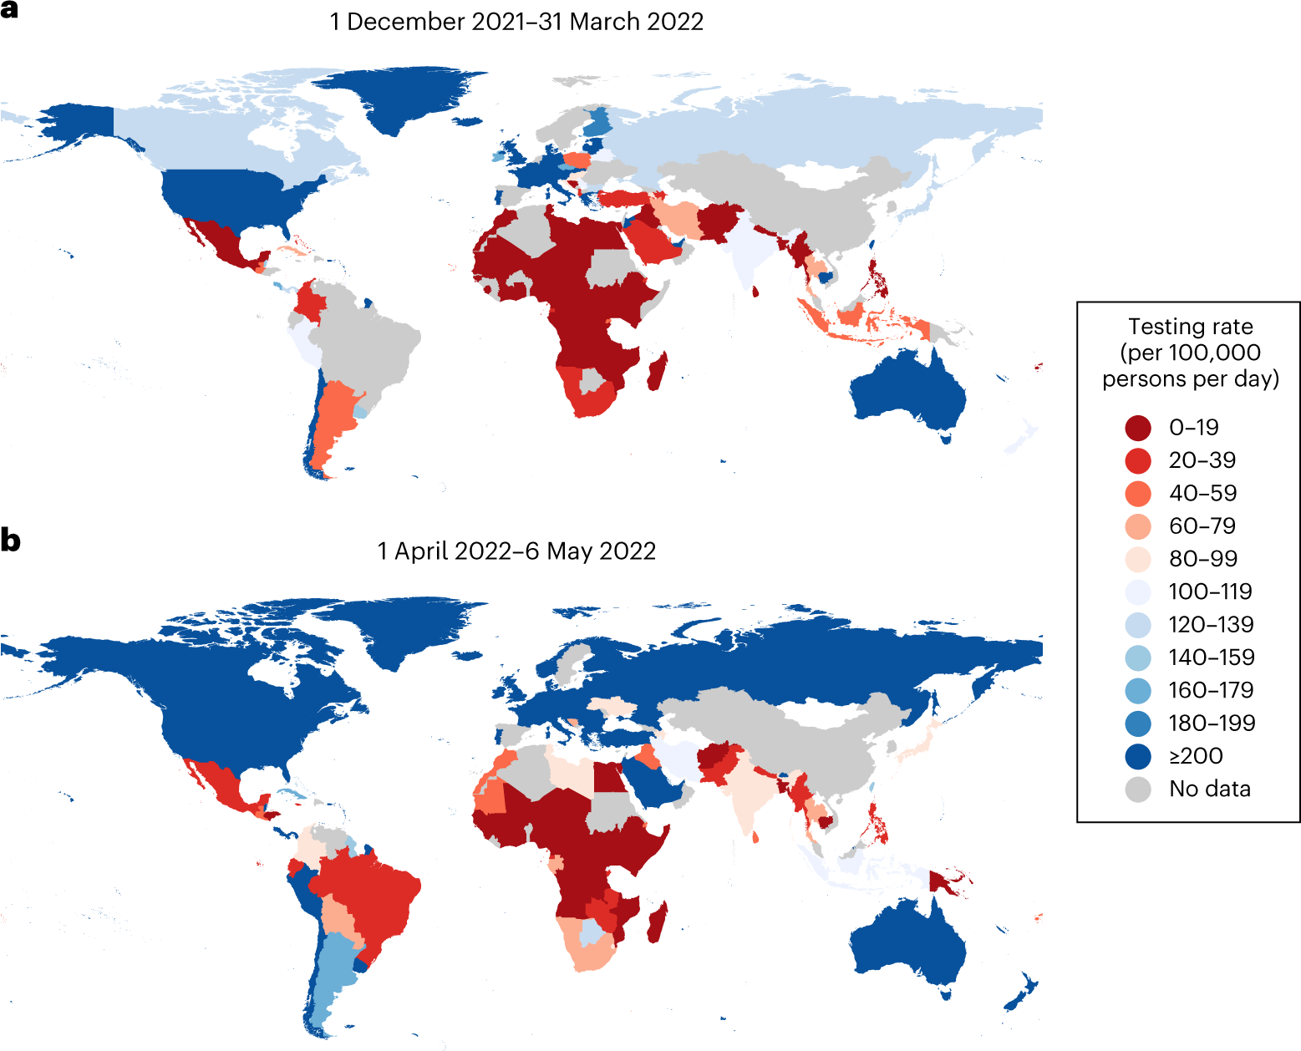
But there are still many, many gains to be made!
Han et al. 2023. Nature Genetics.

Slide 9
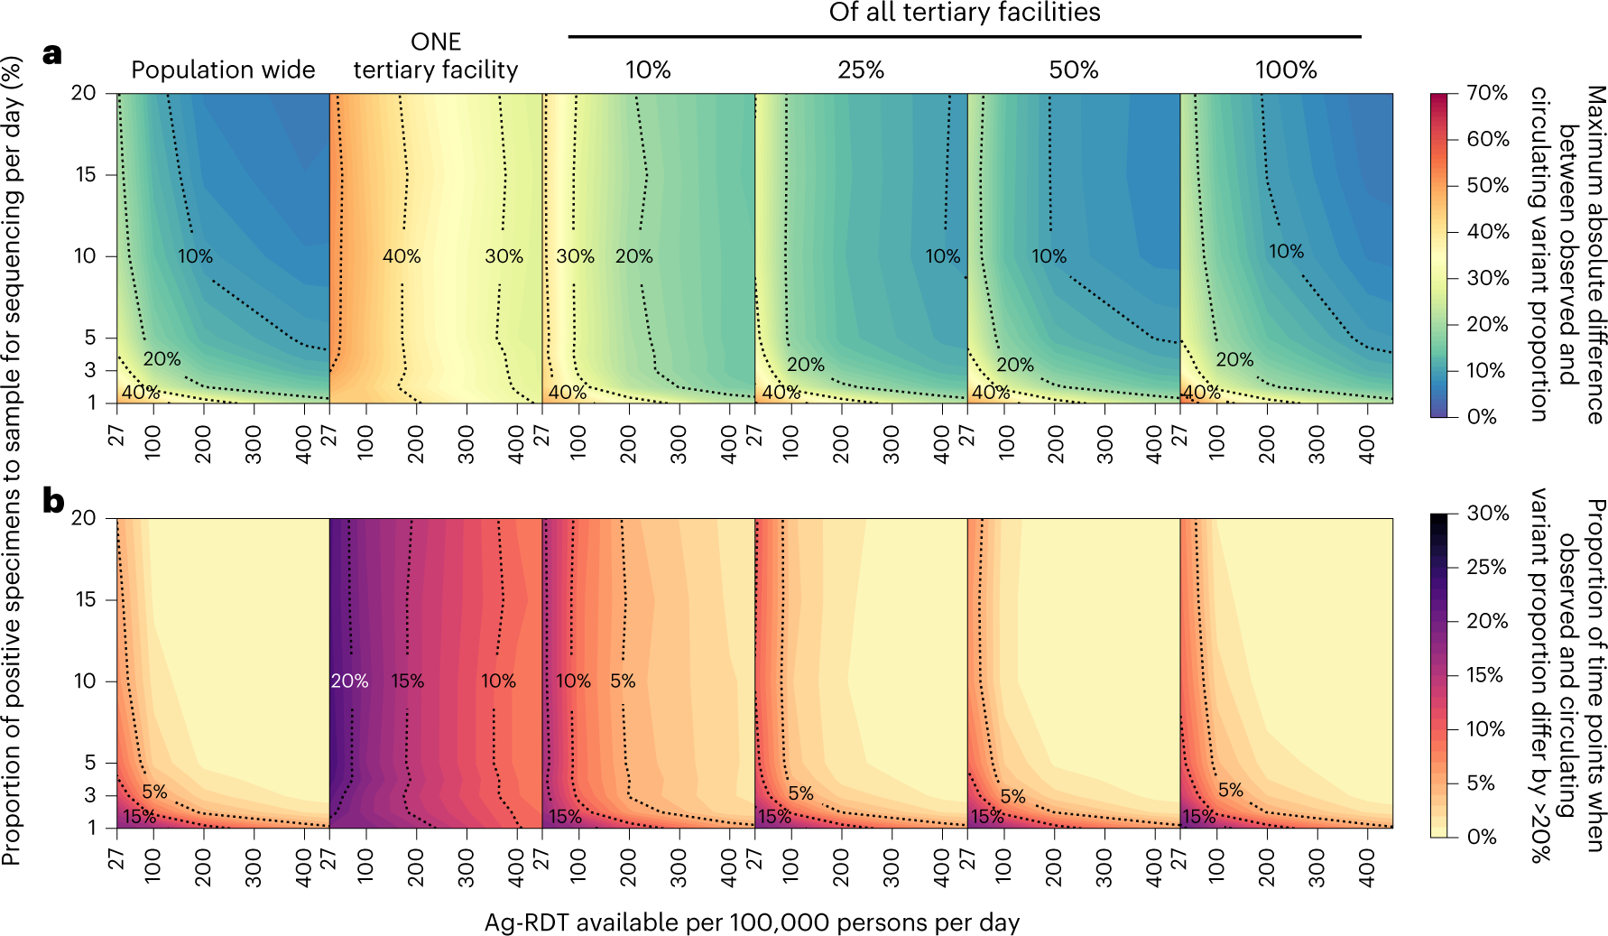
Han et al. 2023. Nature Genetics.

